Slide 1
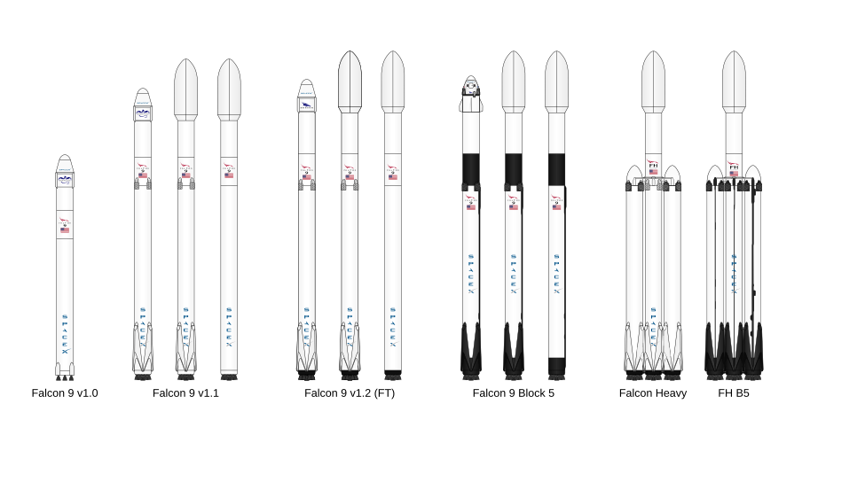
SpaceX Falcon 9
Launch Success Prediction
Applied Data Science Capstone final report
Finnred Fernandes
An end-to-end analysis covering data collection, wrangling, SQL, interactive visual analytics, dashboards, and machine learning.
Key outputs: 90 launches analyzed • 67% success rate • 80 engineered features
Notes:
[Sources] - Rocket family visual derived from Falcon9_rocket_family.svg downloaded from the IBM Skills Network course assets in this workspace. - Project scope and terminology synthesized from the user-uploaded IBM course notebooks and the Final Project Overview text shared in chat. [/Sources]

Slide 2
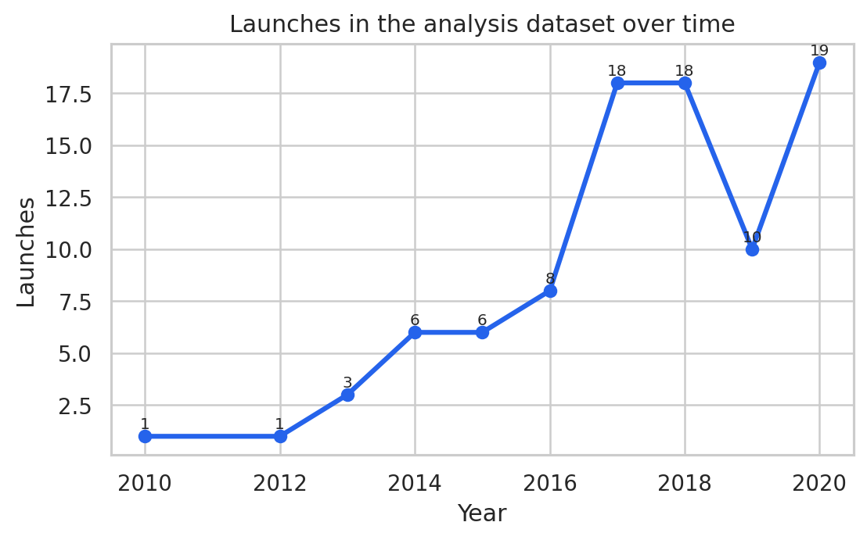
Executive summary
The capstone combined historical SpaceX launch data, visual analytics, and classification models to understand and predict first-stage landing success.
The working dataset contains 90 Falcon 9 launches, 3 launch sites, and 11 orbit classes after cleaning and target-label creation.
Landing success improved over time and was strongest at KSC LC-39A and VAFB SLC 4E, while GTO missions remained the most challenging.
Interactive analytics (Folium + Dash) made the findings easy to explore, while machine learning turned the insights into a predictive workflow.
90
67%
80
Falcon 9 launches analyzed
overall landing success
one-hot encoded features
The number of launches rose sharply in 2017-2020, creating a richer learning signal for both descriptive and predictive analysis.
Notes:
[Sources] - Statistics and timeline chart derived from dataset_part_1.csv and the user-uploaded Data Wrangling / EDA notebooks in this workspace. [/Sources]

Slide 3
Business problem and analytical workflow
SpaceX advertises reusable launches at a lower price point, so accurately understanding landing success matters for cost, cadence, and mission planning.
Objective
1
Collect
2
Wrangle
3
EDA
Predict whether the Falcon 9 first stage lands successfully and explain the operational patterns that drive that outcome.
SpaceX API, Wikipedia scraping, and course CSVs
Clean fields, handle nulls, build class labels
Charts and SQL
Why it matters
A successful landing lowers the cost of reusing boosters and improves future launch economics.
Operationally, launch site, orbit, and payload affect the probability of a controlled return.
4
Interactive analytics
5
Modeling
Folium mapping and Plotly Dash filters
Feature engineering, scaling, train/test split, GridSearchCV
Decision support outcome
A technically detailed report that explains historical patterns, shows interactive outputs, and demonstrates a predictive model for landing success.
Final report structure mirrors the IBM capstone rubric: methodology + results for collection, wrangling, EDA, SQL, map, dashboard, and predictive analysis.
Notes:
[Sources] - Project framing is based on the user-uploaded IBM Applied Data Science Capstone notebooks and the Final Project Overview text shared in chat. [/Sources]

Slide 4
Data collection methodology
The project assembled launch information from multiple sources so the later visual and predictive steps all used the same SpaceX mission context.
Collection outputs used throughout the capstone
1
SpaceX API
Data asset | Rows / purpose
dataset_part_1.csv | 90 launches, 17 columns, core launch records
Spacex.csv | 101 rows, SQL practice and aggregation queries
spacex_launch_geo.csv | 56 rows, map coordinates + class labels
spacex_launch_dash.csv | 56 rows, interactive dashboard data
Historical launches plus related fields such as rocket, payload, core, and launchpad metadata.
2
Wikipedia scraping
Falcon 9 / Falcon Heavy launch tables parsed with BeautifulSoup for additional launch-record context.
3
Course data assets
The launch count accelerates after 2016, which is why later years dominate the visual trend lines and model training signal.
Curated CSVs used for EDA, Folium, Dash, SQL, and machine learning sections of the capstone.
Unified result: one Falcon 9 analysis dataset with 17 core fields before label creation and feature engineering.
Notes:
[Sources] - Methodology comes from the user-uploaded API, Web Scraping, Data Wrangling, SQL, map, dashboard, and machine-learning notebooks. - Launch counts and data-asset sizes derived from dataset_part_1.csv, Spacex.csv, spacex_launch_geo.csv, and spacex_launch_dash.csv in this workspace. [/Sources]

Slide 5
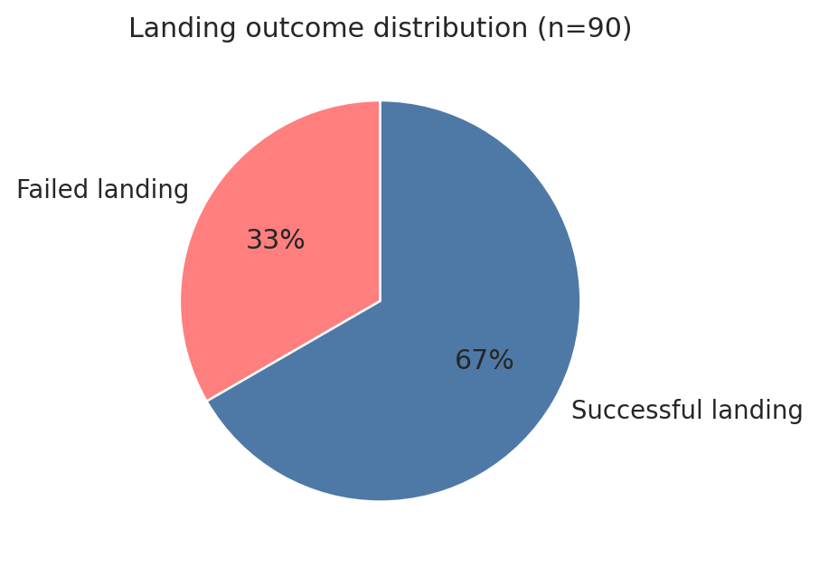
Data wrangling methodology
Wrangling turned raw launch outcomes into a supervised-learning target and prepared the data for consistent analysis across notebooks.
Main wrangling steps
Created the binary target variable Class: successful outcomes mapped to 1 and failed / attempted outcomes mapped to 0.
Verified launch-site and orbit distributions and preserved the numeric fields required later for visualization and machine learning.
Retained 90 Falcon 9 records and used the course-defined outcome rules so quiz answers and later labs stay consistent.
Examples of successful outcomes
Mapped to the failure class
True ASDS
True RTLS
True Ocean
False Ocean
False ASDS
False RTLS
None ASDS / None None
Resulting class balance: 60 successful vs 30 failed launches, or roughly a 2:1 split.
Notes:
[Sources] - Class-label logic derived from the user-uploaded Data Wrangling notebook and dataset_part_1.csv. - Pie chart derived from the locally generated wrangling output in this workspace. [/Sources]

Slide 6
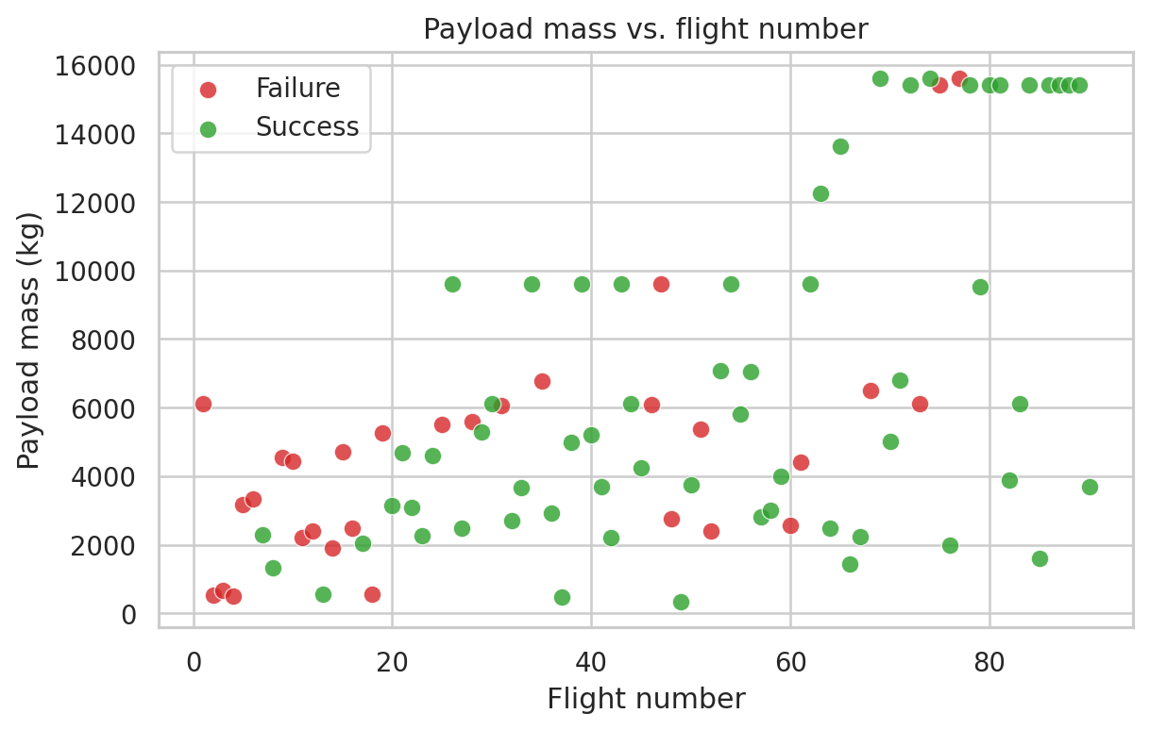
EDA and interactive visual analytics methodology
The analytical questions progressed from descriptive plots to SQL, geospatial analysis, and dashboard interactions.
Questions answered during EDA
How did landing performance change as SpaceX flew more missions and carried heavier payloads?
Which launch sites and orbit classes were most associated with successful returns?
What complementary views could SQL, Folium, and Dash add beyond static charts?
1
2
3
4
Matplotlib / seaborn plots
→
SQLite query views
→
Folium map layer
→
Dash
The scatter plot immediately shows why EDA mattered: payload alone does not determine success; trajectory and operational context matter too.
Notes:
[Sources] - Scatter plot derived from dataset_part_1.csv after applying the Data Wrangling notebook logic. - Methodology sequence synthesized from the user-uploaded EDA, SQL, map, dashboard, and machine-learning notebooks. [/Sources]

Slide 7
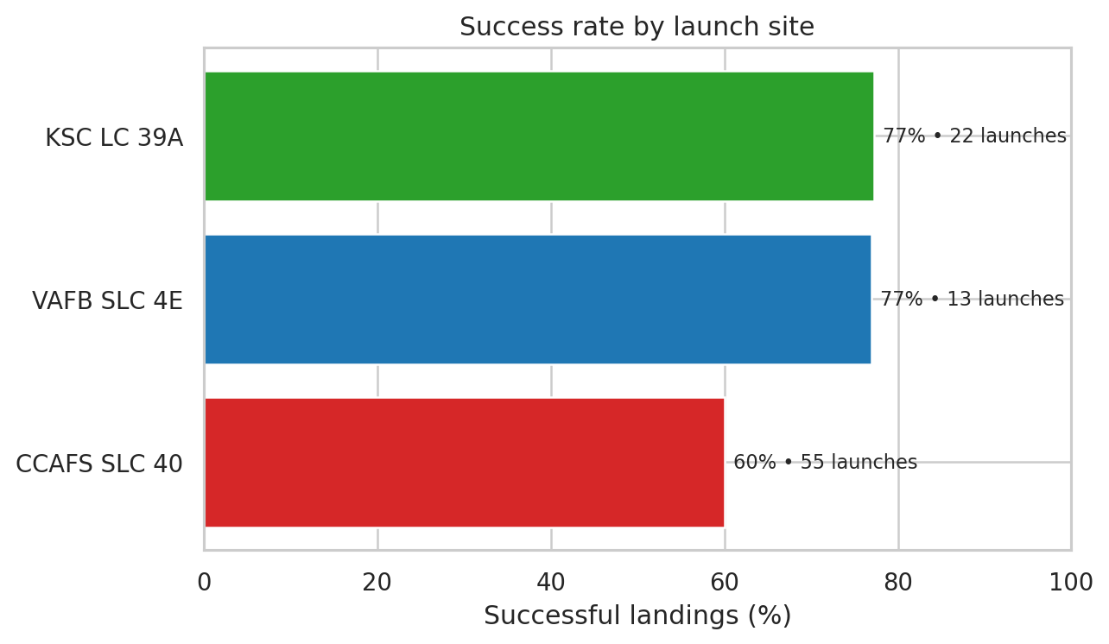
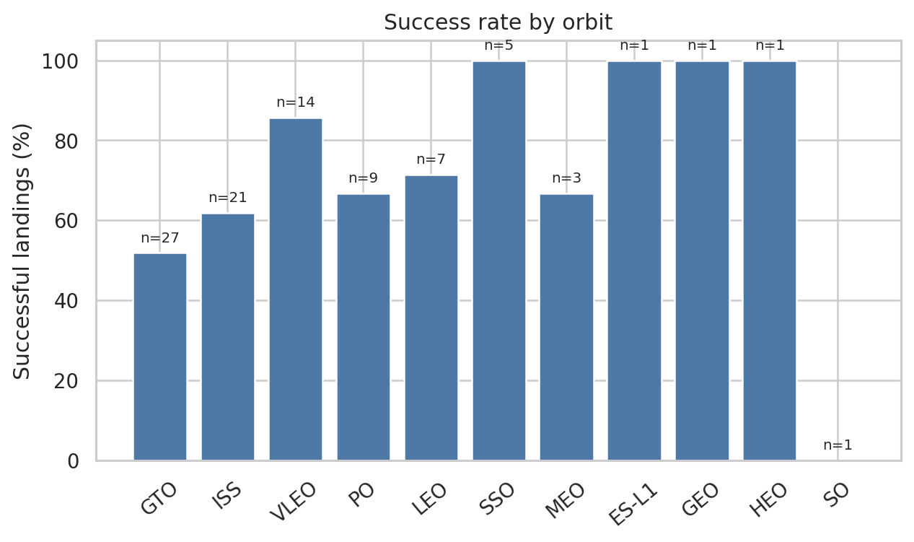
EDA with visualization results
Site and orbit views surfaced the main historical patterns before moving into SQL and interactive tools.
Key finding: KSC LC-39A and VAFB SLC 4E delivered about 77% success, while VLEO / SSO / GEO-class missions were more favorable than GTO missions.
Notes:
[Sources] - Both charts derived from dataset_part_1.csv after applying the class-label logic from the Data Wrangling notebook. [/Sources]

Slide 8
EDA with SQL results
SQL provided a compact way to validate site counts, payload summaries, and landing milestones directly from tabular mission records.
Query insight | Result
Distinct launch sites | CCAFS LC-40, CCAFS SLC-40, KSC LC-39A, VAFB SLC-4E
Total NASA CRS payload | 48,213 kg
Average payload (F9 v1.1) | 2,928 kg
First successful ground-pad landing | 2015-12-22
Mission outcomes by site | CCAFS LC-40: 26 • CCAFS SLC-40: 34 • KSC LC-39A: 16 • VAFB SLC-4E: 25
Representative query pattern
SELECT Launch_Site, COUNT(Mission_Outcome)
AS mission_outcome_count
FROM SPACEXTBL
GROUP BY Launch_Site;
Why SQL added value
Fast validation of payload and site-level summaries
Easy grouping for mission outcomes and filtered subsets
A reproducible bridge between raw records and later visuals
These outputs aligned the SQL notebook with the same story seen in the plots: payload profile, launch site, and landing context all matter.
Notes:
[Sources] - SQL insights derived from Spacex.csv and the user-uploaded EDA with SQL notebook in this workspace. [/Sources]

Slide 9
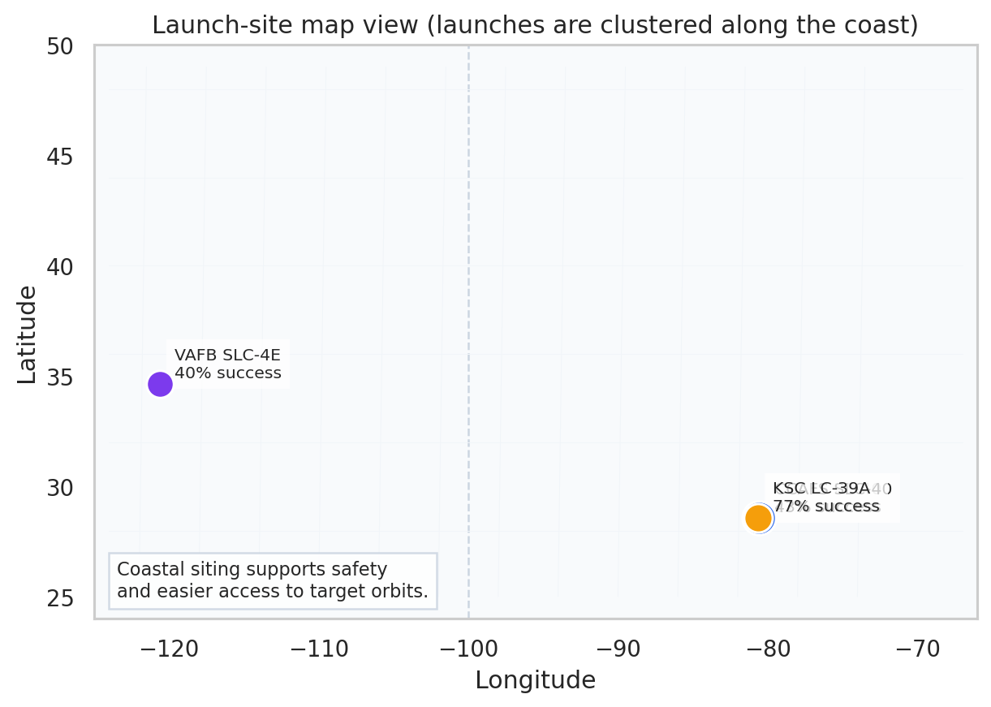
Interactive map results using Folium
Geospatial analysis showed that SpaceX launch sites are positioned along the coast, balancing safety requirements with orbital access.
Location-based observations
All analyzed launch sites are coastal, which reduces risk over populated areas and supports targeted orbital paths.
KSC LC-39A and CCAFS SLC 40 cluster in Florida for eastward launches; VAFB SLC 4E supports polar / sun-synchronous trajectories from California.
Mapped markers make site comparisons more intuitive than a table alone and help explain why geography belongs in the business story.
Site snapshot
CCAFS SLC 40: 55 launches, 60% success
KSC LC 39A: 22 launches, 77% success
VAFB SLC 4E: 13 launches, 77% success
Notes:
[Sources] - Map visual derived from spacex_launch_geo.csv and the user-uploaded Folium notebook; slide summarizes the map-focused findings rather than a live interactive map. [/Sources]

Slide 10
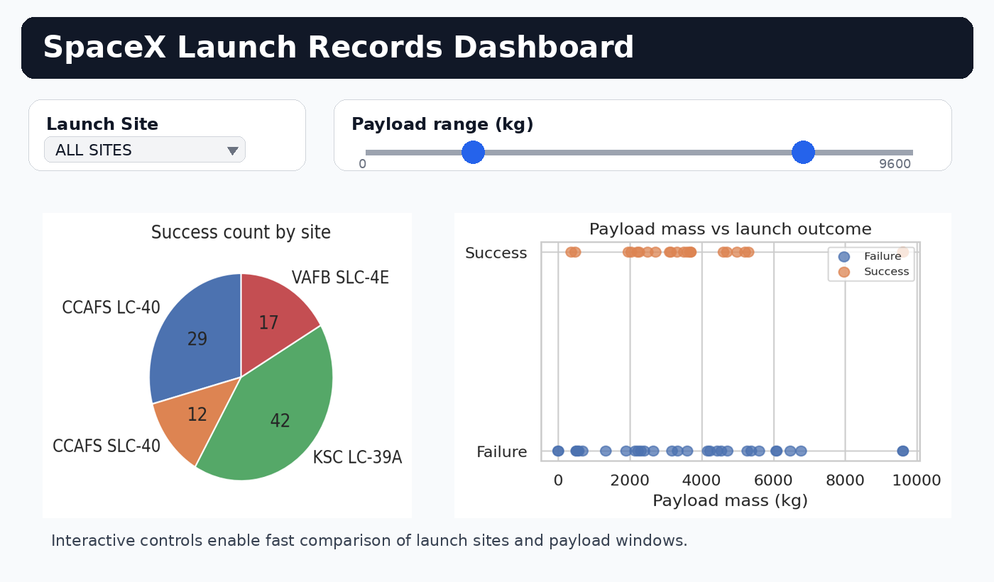
Plotly Dash dashboard results
The dashboard turned the same launch data into an exploratory interface with filters for launch site and payload range.
What the dashboard adds: the dropdown isolates one site or compares all sites at once, and the payload slider turns the app into a quick "what range works best?" diagnostic.
Notes:
[Sources] - Dashboard view derived from spacex_launch_dash.csv and the user-uploaded Plotly Dash notebook and dashboard PDF in this workspace. [/Sources]

Slide 11
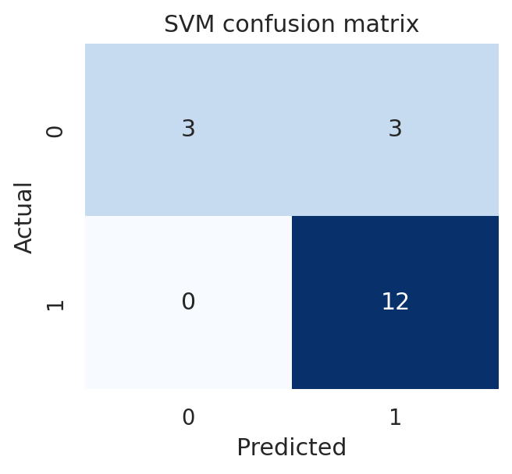
Predictive analysis methodology
The classification stage converted the cleaned launch data into 80 numeric features and used model selection to compare multiple algorithms.
1
Feature engineering
2
Preprocess
3
Split
4
Tune
5
Score
One-hot encoded Orbit, LaunchSite, LandingPad, and Serial to create 80 numeric inputs.
→
StandardScaler applied before model fitting.
→
Train/test split with 20% test data (72/18 rows).
→
10-fold GridSearchCV for logistic regression, SVM, decision tree, and KNN.
→
Compare
Modeling details worth calling out
The course notebook’s best SVM kernel on validation was sigmoid.
The first course run reported 83.33% decision-tree test accuracy; reruns can shift because the tree search includes randomized settings.
Using a held-out test set keeps the final score more honest than relying on cross-validation alone.
Notes:
[Sources] - Methodology derived from the user-uploaded Machine Learning Prediction notebook and the locally generated feature matrix based on dataset_part_1.csv. [/Sources]

Slide 12
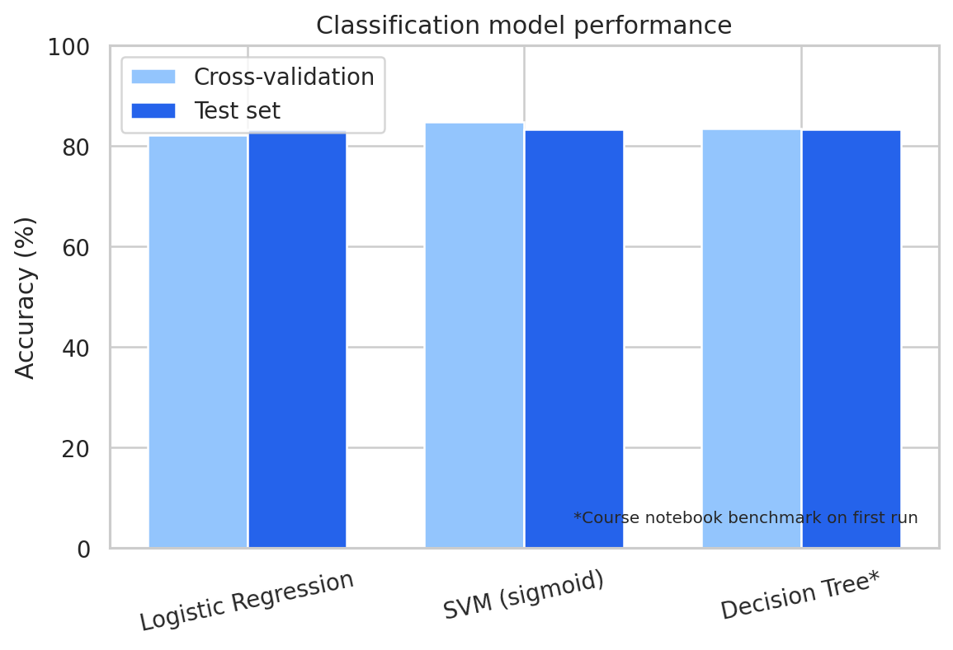
Predictive analysis results
The final comparison showed that the project’s engineered features capture enough signal to support practical landing-success predictions.
Best validation model
SVM with sigmoid kernel
Headline benchmark
83.33% course test accuracy
Interpretation
A compact feature set built from site, orbit, payload, and booster context is enough to produce robust predictions on this dataset.
The model is best understood as a decision-support tool: it highlights conditions associated with success rather than replacing mission engineering.
Notes:
[Sources] - Model chart blends locally rerun validation results with the course notebook benchmark discussed throughout the conversation and reflected in the user-uploaded ML notebook context. [/Sources]

Slide 13
Conclusion and recommendations
The capstone tells a coherent operational story: landing success is learnable, explainable, and actionable when the right features are assembled.
What the project demonstrated
Suggested next steps
Historical launch data can be cleaned into a clear supervised-learning problem without losing the operational meaning of the records.
Static plots, SQL summaries, map views, and dashboards each surfaced different parts of the same story and reinforced one another.
Machine learning made the story predictive by translating the cleaned signals into an 83%+ benchmark on the course test workflow.
Add newer launch data and retrain the classification pipeline on a refreshed sample.
Test more explainability methods (feature importance, SHAP) to show why the model predicts success or failure for a given mission.
Extend the dashboard with model predictions so stakeholders can interact with both descriptive and predictive views in one place.
Most important practical insight
Success is not driven by payload alone. Launch site, orbit, and mission context determine whether a payload profile is recoverable.
Notes:
[Sources] - Conclusions synthesize the data and model outputs derived from the user-uploaded capstone notebooks and local dataset files in this workspace. [/Sources]

Slide 14
Submission checklist and deliverables
This final slide makes the IBM rubric actionable before you export to PDF and submit.
Final export steps
Add your GitHub repository link before submission
Review the deck once in PowerPoint or LibreOffice and verify that images, notes, and slide numbers are intact.
Convert the presentation to PDF and upload the PDF, not the PPTX, if the rubric requires PDF for grading.
Keep the notebooks / scripts in your GitHub repo so the submission has both the report and the reproducible work.
Replace this placeholder with the repository that contains all completed notebooks and Python files:
https://github.com/<your-username>/<your-spacex-capstone-repo>
Rubric item | Covered in deck
Executive summary + introduction | Slides 2-3
Collection / wrangling methodology | Slides 4-5
EDA / SQL / map / dashboard results | Slides 6-10
Predictive analysis methodology + results | Slides 11-12
Conclusion + creativity / insights | Slide 13
Ready-to-submit package from this workspace
• Final PowerPoint presentation
• Matching PDF export
• User-updated notebooks and generated visuals
Notes:
[Sources] - Checklist wording based on the Final Project Overview text supplied by the user in chat. [/Sources]

